Slide 1
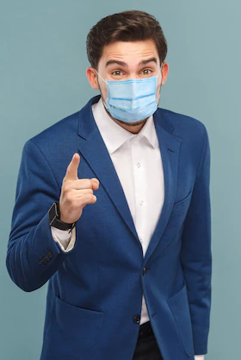
Touchless Token Generation for Hospitals (Computer Vision based Virtual mouse and keyboard Events)
Guided by:
Divya S K
Dept of Computer Applications
Surya S
S4 MCA
TVE20MCA-2066

Slide 2
Introduction
Touchless token generation for hospitals is a software solution enabling hospitals to effectively manage appointments of walk-in patients by assigning them tokens without touching screen or any objects.
It helps in reducing wait times, increasing customer satisfaction and reducing spread of contact diseases .
The proposed system can be used to overcome the existing manual token dispenser by employing webcam or a built-in camera for capturing hand gestures and hand tip detection using computer vision to generate tokens.
The algorithm used in the system makes use of deep learning algorithm detecting the hands to control the computer.
Based on the hand gestures, the computer can be controlled virtually and can perform token generation without the use of the physical mouse or keyboard.

Slide 3
Problem Statement
A socially relevant topic needs to be addressed as part of the project.
According to the World Health Organization, around 3 million people in the world are affected by covid19 from hospitals through unsanitary touch and unsafe conditions.
We need to consult doctors in hospitals and it is important that no other diseases are consumed during the visit.
So to avoid spreading of contact diseases and to ensure social distancing, a software system is built for token generation.

Slide 4
Literature Review
1. H. Zhu, M. Hou, C. Wang and M. Zhou, "An Efficient Outpatient Appointment Scheduling Approach," in IEEE Transactions on Automation Science and Engineering, vol. 9, no. 4, pp. 701-709, Oct. 2012, https://doi.org/10.1109/TASE.2012.2207453..
The proposed systems facilitate pre booking of appointments for consultation. And has not considered the chances of walk-in token generation chaos.
The proposed approaches is validated by generated patient requests for available time slots.
Even if for a good appointment system, there is a large possibility of arrival and service time variability.
Users requires reliable Internet access. As internet service is not a barrier for getting treatment. It is also worth noting that not everyone is computer-savvy. Some patients might find it difficult to find or fill out appointment forms.

Slide 5
Literature Review
2. Horatiu-Stefan Grif and Cornel Cristian Farcas proposed “Mouse Cursor Control System Based on Hand Gesture”.
The paper have some connected works applied on virtual mouse system hand gesture detection by wearing a glove and the use of color objects for gesture recognition and they are not so accurate in mouse functions.
3. D Liou et al [3] 2010 planned a study on “A period of time Hand Gesture Recognition System victimization Motion History Image.”
The limitation of this model was a lot of sophisticated hand gestures for mouse movement and functions. But, solely a few mouse functions are performed.

Slide 6
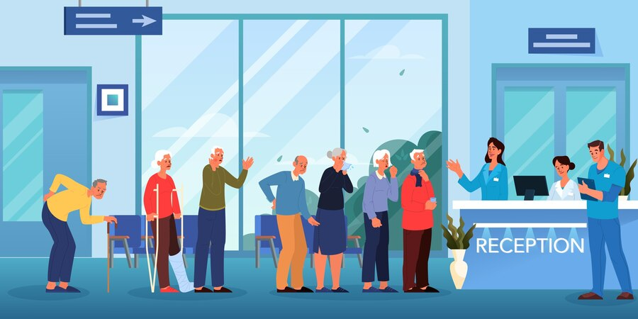
Existing System
1. Manual handwritten token
Tokens are issued by the receptionist by writing on a piece of paper.
Manual
Details of patients is mentioned along with token number
Chances of unsanitary touch
Time consuming

Slide 7
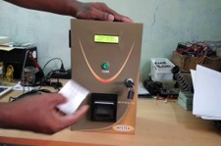
Existing System
2. Token dispenser
Token dispenser can be used in stand-alone mode to print token slips by pressing Token key.
Automated
Details of patients is not mentioned along with token number
Chances of unsanitary touch

Slide 8
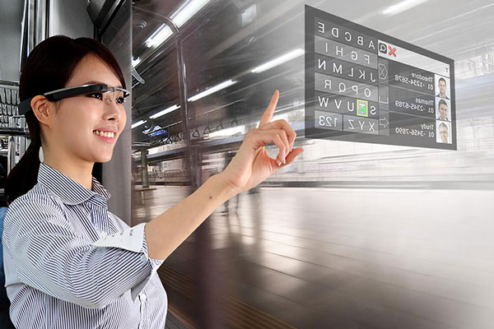
Proposed System
Touchless token generation for hospitals is a software solution enabling hospitals to effectively manage appointments of walk-in patients by assigning them tokens without touching screen or any objects.
The proposed system employs a webcam or a built-in camera for capturing of hand gestures and hand tip detection using computer vision to generate tokens.
The details of the patient can be entered by moving the hand across the web cam and pointing it to the corresponding letter on the system screen.
Hence capturing of hand gestures and hand tip detection using computer vision can be used to enter details and move cursor so as to generate tokens.
Stand-alone Automated System
Avoids unsanitary touch.

Slide 9
Requirements
Hardware requirements
Software details
Virtual mouse:
Platform : Python
Libraries used : MediaPipe, OpenCV, AutoPy, numpy
Token generation system:
Language: Php
Front end: Html, CSS , JavaScript
Web Server: Apache
Database: Mysql
IDE: Visual Studio Code
• Processor : Intel Core i3.
• Storage : 512 GB Hard Disk space.
• Memory : 4 GB RAM.
• Webcam

Slide 10

Touchless Token Generation for Hospitals (Computer Vision based Virtual mouse and keyboard Events)
Login
Set date and notification
User
Admin
Set camera for capturing activity
Start movement of hand
Capture image from camera
Camera
Mapping touch points to click events
Enter details
Generate Tokens
Use Case Diagram

Slide 11
Initialize the system and start the video capturing of webcam
Capture frames using webcam
Detect hands and hand tips using mediapipe and opencv and draw the hand landmarks
RGB images from webcam
Draw a rectangle box, this is the region of the pc window where we are going to use mouse
Detect which finger is up
Flowchart of real time virtual mouse events
Mouse cursor moving around the window
If index finger is up
If both index and middle fingers are up and length between them is below 36px
Perform click operation
No action is performed
If any other fingers are up
Press stop to terminate

Slide 12
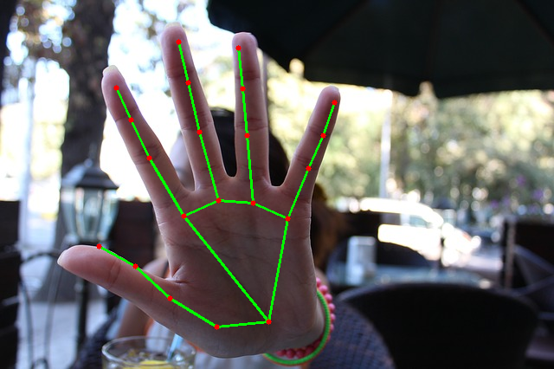
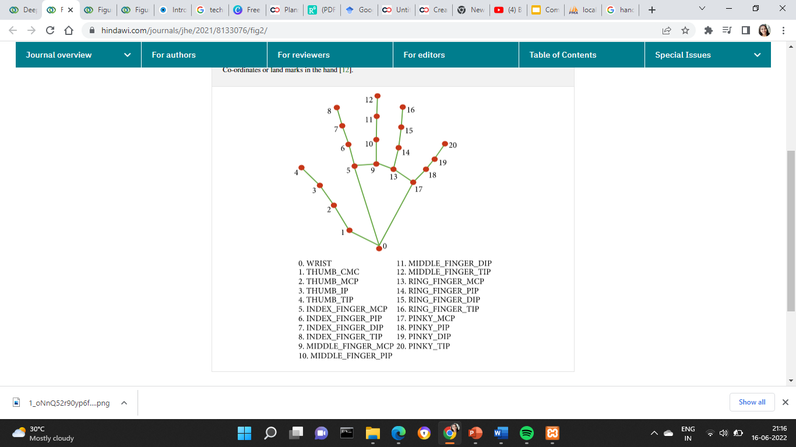
Algorithm used for cursor control
The algorithm used in the system makes use of the deep learning algorithm detecting the hands to control the computer.
OpenCV library is used for computer vision. It gives live feed to track hand.
For the purpose of detection of hand gestures and hand tracking, the MediaPipe framework is used.
Autopy is used for converting hand movements to mouse movements.

Slide 13
Algorithm
Logging and setting date & notification by admin.
Set camera for capturing activity and start movement of hands.
System does the following:
i. Find the hand landmark.
ii. Get the tip of the index and middle finger.
iii. Check which fingers are up.
iv. Based on the information from step iii, it will check whether it is in moving mode. Only Index finger is up: Moving mode.
v. Both index and middle fingers are up and distance between them is between a certain range: Clicking mode.
User can enter details and generate tokens.
The token number and details are displayed on the corresponding departments screen.

Slide 14
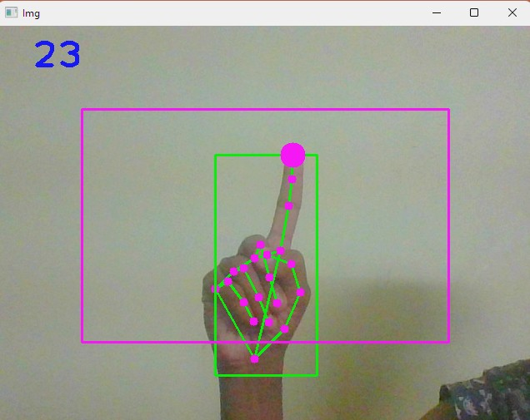
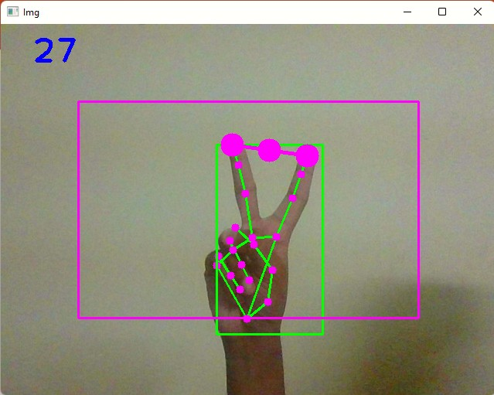
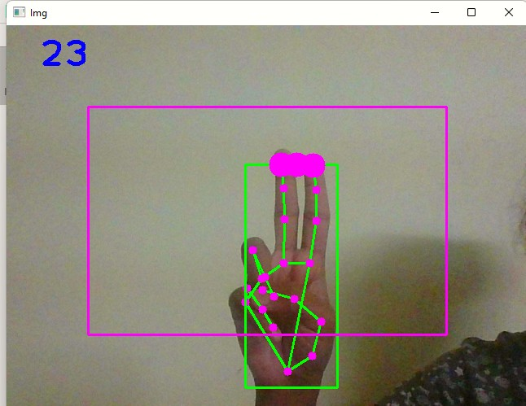
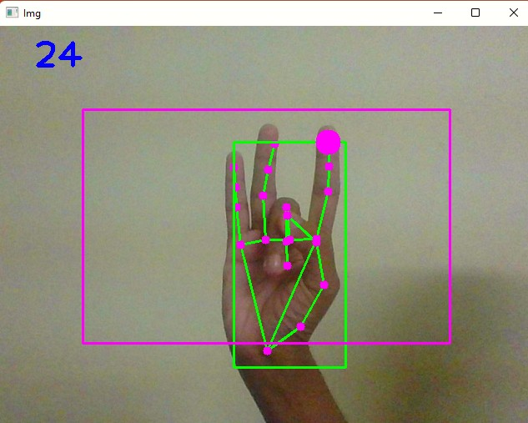
Implementation
For the purpose of detection of hand gestures and hand tracking, the MediaPipe framework is used, and OpenCV library is used for computer vision.
The algorithm makes use of the machine learning concepts to track and recognize the hand gestures and hand tip.
1. Mouse Movement
2. Click function
3. Stop function

Slide 15
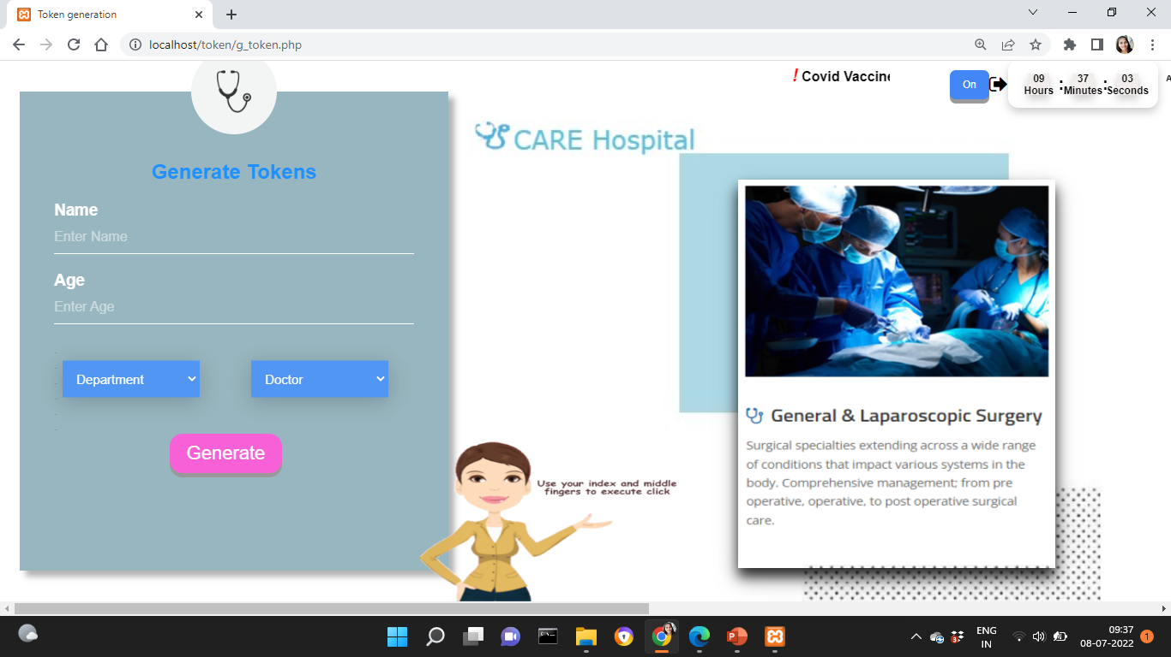
Implementation
The details of the patient can be entered by moving the hand across the web cam and pointing it to the corresponding letter on the system screen.
Hence capturing of hand gestures and hand tip detection using computer vision can be used to enter details and move cursor so as to generate tokens.

Slide 16
Testing
Test case id | Scenario | Boundary Value | Expected Result | Actual Result | Status
1 | Used in normal environment. | greater than 90% | In normal environment hand gestures can be recognized easily. | Hand gestures got easily recognized and work properly. | Passed
2 | Used in bright environment. | greater than 60% | In brighter environment, software should work fine as it easily detects the hand movements but in a more brighter conditions it may not detect the hand gestures as expected. | In bright conditions the software works very well | Passed
3 | Used in dark environment | less than 30% | In dark environment, It should work properly | In dark environment software did not work properly in detecting hand gestures. | Failed
4 | Used at a near distance 15cm and 45 from the web cam. | greater than 80% | At this distance, this software should perform perfectly | It works fine and all features works properly | Passed

Slide 17
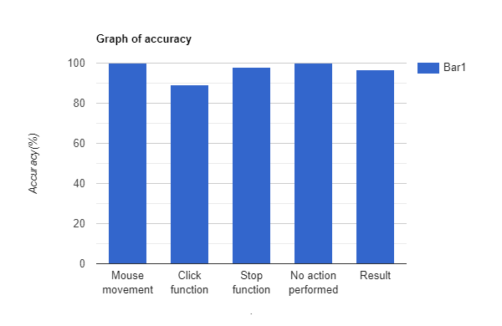
Performance Testing
Hand tip gesture | Mouse function performed | Success | Failure | Accuracy (%)
Tip ID 1 is up | Mouse movement | 100 | 0 | 100%
Tip IDs 1 and 2 are up and the distance between the fingers is <40 | Click function | 89 | 11 | 89%
Tip ID 1,3,4 are up | Stop function | 98 | 2 | 98%
All five tip IDs 0, 1, 2, 3, and 4 are up | No action performed | 100 | 0 | 100%
Result |  | 387 | 13 | 96.75%

Slide 18
Advantages
Reduces the use of additional hardware like a mouse and keyboard.
Free of cost.
Using of module Mediapipe increase the accuracy and performance of the system.
Stand-alone Automated System.
Avoids unsanitary touch.

Slide 19
Limitations
The current system will not produce more accurate result under low light .
The mouse event performed can be found as slow, but it can be improved using high performing systems.

Slide 20
Conclusion
Suggested system design will fundamentally alter how humans interact with our computer.
Based on the hand gestures, the computer can be controlled virtually and can perform token generation without the use of the physical mouse or keyboard.
The project helps in reducing wait times, increasing customer satisfaction and reducing spread of contact diseases.

Slide 21
Future Scope
Token generation system can be used in any cases for a contactless interactions in offices, banks, clinics etc.
Also the proposed system can be expanded and can include the prescription by doctors which is then send to the patients through SMS.
The improvements include identifying the hand even in low light and also identify the hand even if wearing gloves.

Slide 22
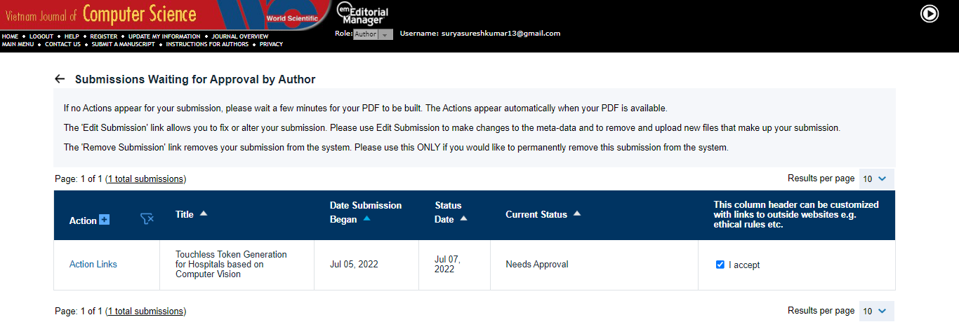
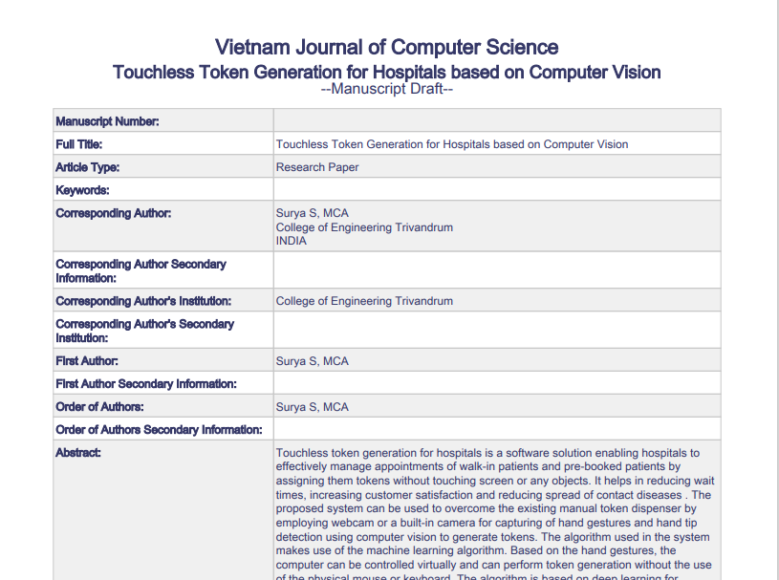
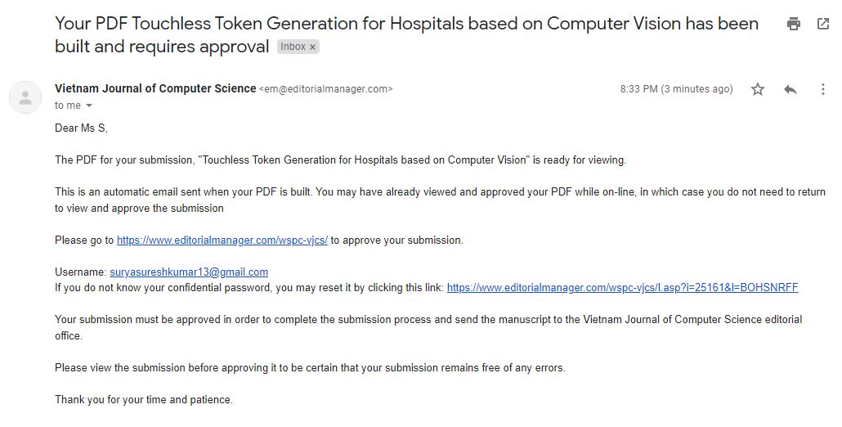
Journal Publication

Slide 23
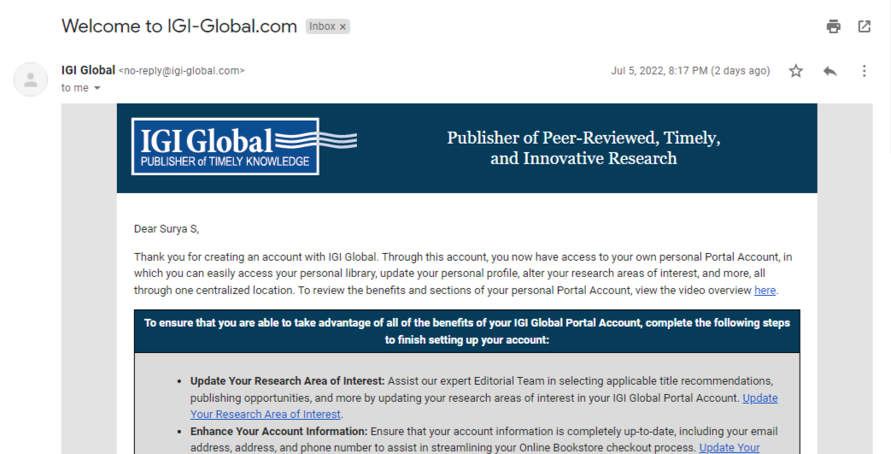
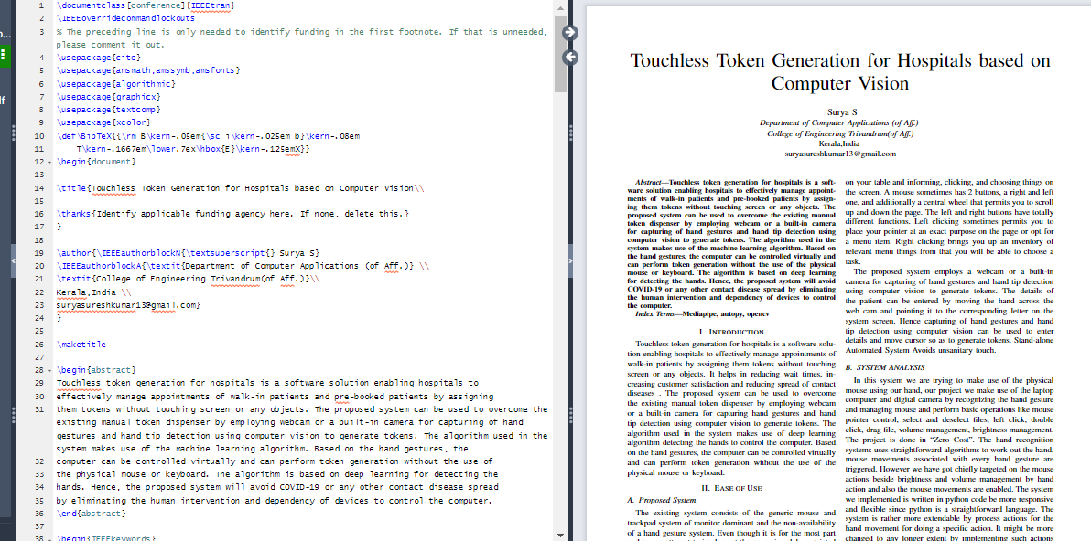
Journal Publication

Slide 24
References
M. Ranawat, M. Rajadhyaksha, N. Lakhani and R. Shankarmani, "Hand Gesture Recognition Based Virtual Mouse Events," 2021 2nd International Conference for Emerging Technology (INCET), 2021.
K. H. Shibly, S. Kumar Dey, M. A. Islam and S. Iftekhar Showrav, "Design and Development of Hand Gesture Based Virtual Mouse," 2019 1st International Conference on Advances in Science, Engineering and Robotics Technology (ICASERT), 2019.

Slide 25
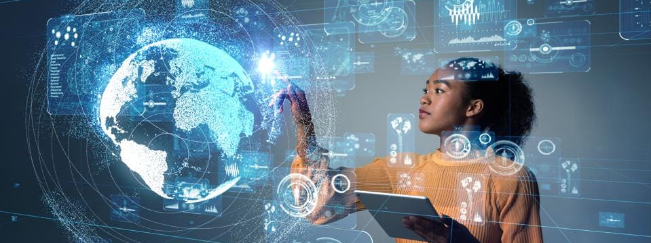
“We’re changing the world with technologies…”
THANK YOU

